Slide 1
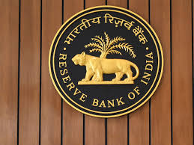
Banking - Payments Systems

Slide 2
Overview
The Central Bank of any country is usually the driving force in the development of national payment systems. The Reserve Bank of India as the central bank of India has been playing this developmental role and has taken several initiatives for Safe, Secure, Sound, Efficient, Accessible and Authorised payment systems in the country.
The Board for Regulation and Supervision of Payment and Settlement Systems (BPSS), a sub-committee of the Central Board of the Reserve Bank of India is the highest policy making body on payment systems in the country. The BPSS is empowered for authorising, prescribing policies and setting standards for regulating and supervising all the payment and settlement systems in the country.
In India, the payment and settlement systems are regulated by the Payment and Settlement Systems Act, 2007 (PSS Act) which was legislated in December 2007. The PSS Act as well as the Payment and Settlement System Regulations, 2008 framed thereunder came into effect from August 12, 2008. In terms of Section 4 of the PSS Act, no person other than the Reserve Bank of India (RBI) can commence or operate a payment system in India unless authorised by RBI.
Source: Maveric-Systems

Slide 3
Electronic Payments Systems
Payments Systems
RTGS – Real Time Gross Settlement
NEFT – National Electronic Fund Transfer
IMPS – Immediate Payment Services
Standing Orders
Source: Maveric-Systems

Slide 4
RTGS – Real Time Gross Settlement
The acronym 'RTGS' stands for Real Time Gross Settlement, which can be defined as the continuous (real-time) settlement of funds individually on an order by order basis (without netting). 'Real Time' means the processing of instructions at the time they are received rather than at some later time. 'Gross Settlement' means the settlement of funds transfer instructions occurs individually (on an instruction by instruction basis). Considering that the funds settlement takes place in the books of the Reserve Bank of India, the payments are final and irrevocable.
Benefits of RTGS
It is a safe and secure system for funds transfer.
There is real time transfer of funds to the beneficiary account.
Remitter can initiate the remittances from his / her home / place of work using internet banking, if his / her bank offers such service.
The transaction charges have been capped by RBI.
The transaction has legal backing.
Source: Maveric-Systems

Slide 5
NEFT – National Electronic Fund Transfer
National Electronic Funds Transfer (NEFT) is a nation-wide payment system facilitating one-to-one funds transfer. Under this Scheme, individuals can electronically transfer funds from any bank branch to any individual having an account with any other bank branch in the country participating in the Scheme.
Benefits of NEFT
No physical presence of either party is required to conduct a transaction..
NEFT is simple and efficient.
Confirmation of a successful transaction can be easily received and viewed through email and SMS notifications.
Internet banking can be initiated and conducted from any place.
Real time transactions provide assurance to both the parties.
Source: Maveric-Systems

Slide 6
IMPS – Immediate Payment Service
Immediate Payment Service (IMPS) is an instant payment inter-bank electronic funds transfer system in India. IMPS offers an inter-bank electronic fund transfer service through mobile phones. Unlike NEFT and RTGS, the service is available 24*7 throughout the year including bank holidays.
Benefits of IMPS
Transaction occur in real time , payments occur instantly
Transaction process is simple.
There are no time constraints.
The process ensure secure payments.
Source: Maveric-Systems

Slide 7
Difference between NEFT, RTGS & IMPS
Basis Of Comparison | NEFT | RTGS | IMPS
Minimum Transfer Value | Rs. 1 | Rs. 2 Lakh | Rs. 1
Payment Options | Online and Offline | Online and Offline | Online
Maximum Transfer Value | No Limit | No Limit | Rs. 2 Lakh
Settlement Type | Half Hourly Basis | Real Time | Real Time
Service Timings | 8 AM to 7 PM Working Days | 8 AM to 6 PM Working Days | Available 365 days 24*7
Inward Transaction Charges | No Charges | No Charges | Decided by the Individual Member Banks
Source: Maveric-Systems

Slide 8
Requirements to initiate RTGS,NEFT & IMPS Transaction
The remitting customer has to furnish the following information to a bank for initiating a transfer:
Amount to be remitted
The account number to be debited
Name of the beneficiary bank and branch
IFSC number of the receiving branch
Name of the beneficiary customer
Account number of the beneficiary customer
Sender to receiver information, if any
Source: Maveric-Systems

Slide 9
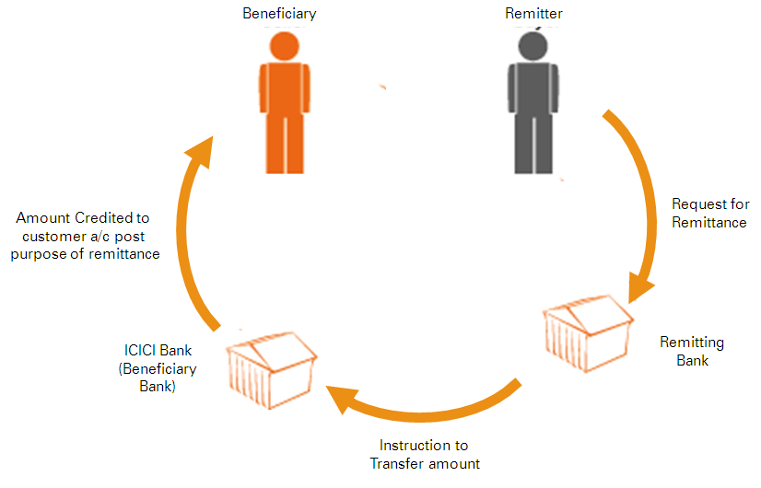
Workflow of Outward Remittance for RTGS,NEFT&IMPS

Slide 10
Remitter wants to transfer to Beneficiary Account who holds account with different bank.
Remitter instructs his bank to pay INR 5000 by debiting his account and mention beneficiary details such as Beneficiary Name, Account Number , IFSC and purpose of transfer.
Remitting bank verify remitter request by verifying his account details whether sufficient balance is available to transfer the amount to beneficiary bank. In certain cases , the bank may need to hold the payments to undertake further checks to protect the remitter.
Remitting bank debits customer account and sends notification stating the amount is being debited and transferred to Beneficiary bank and the UTR ( Unique Transaction Reference) number.
Remitting bank transfer the funds to Beneficiary bank as per the request received by the remitter.
Beneficiary bank receives the payment from remitting bank.

Slide 11
8. Beneficiary Bank validates the payment request received from remitting bank such as Beneficiary Account Number & Account Status.
9. Beneficiary Bank credit beneficiary account and send notification to customer amount credited

Slide 12
Validations for Outward RTGS,NEFT & IMPS
The Sending / Originator bank should validate Outward Payment before transfer
Invalid Debit Account Number
Debit Account Closed
Debit Account Blocked
Debit Account is flagged as Deceased
Invalid IFSC Code
Not updating Beneficiary Account Number
Not Updating Beneficiary Account Name
Funds to be remitted more than available balance in customer account
Payment instruction can’t be issued as per court order attachment
Source: Maveric-Systems

Slide 13
Return Reasons for Inward RTGS,NEFT & IMPS
The receiving / beneficiary bank can return as Inward payments for the following reasons
Beneficiary Account Number unknown
Beneficiary Account Closed
Beneficiary Account Blocked
Beneficiary Deceased
Return requested by sender of original payment
Fraudulent payment suspected
Beneficiary not expecting funds / instructing return
Duplicate Payment
Source: Maveric-Systems

Slide 14
IFSC – Indian Financial System Code
IFSC ( Indian Financial System Code) code is a unique eleven digit number which is a combination of alphabets and numerals. The IFSC code of each bank branch is assigned by the Reserve Bank of India. Internet banking transactions for transferring funds, using NEFT, IMPS and RTGS, can’t be initiated without a valid Indian Financial System Code
Benefits of IFSC
Unique Identification – It helps in identifying a particular bank branch
Elimination Errors – It helps to eliminate any discrepancy in the fund transfer process.
Electronic Payments Made Easier – It is used in electronic payment tools such as RTGS, IMPS and NEFT
Format of IFSC
IFSC code is a unique eleven digit number where the first 4 digits denote the bank name, fifth character is zero and the remaining six digit denote the branch code.
Source: Maveric-Systems

Slide 15
UTR – Unique Transaction Reference
UTR stands for Unique Transaction Reference number. It is a unique number that is generated for recognising any fund transfers and is created by the bank that facilitates transfer. The main purpose is to identify and monitor financial transactions
Format of UTR
UTR number is 22 characters long for RTGS and 16 characters long for NEFT. The format of the UTR number for the RTGS transaction is “XXXXRCYYYYMMDD########”
XXXX – is IFSC ( first four characters) – bank code of a sender
R – represents RTGS system
C – represents channel of the transaction
YYYYMMDD – represents year, month and date of the transaction
######## - denotes the sequence number
Source: Maveric-Systems

Slide 16
Standing Order
A standing order is an automated method of making payments, where a person or business instructs their bank to pay another person or business a fixed amount of money at regular (fixed) intervals. The payer controls the standing order; they set it up themselves, and choose the amount and frequency. Standing orders are created to cover a set period of time (e.g. every month for a year), or until they are cancelled.
Any person or company with a current account can set up a standing order, either online, over the phone or at in person at a branch of their bank.
Benefits of Standing Order
Easy and quick for Payer to setup standing order
Useful for making recurring payments
Helps business to collect regular payments on time
.

Slide 17
Requirements to initiate Standing Order
Customer need to input following details in order to initiate Standing Order
Payee Name
Payee Account Number
Payee Bank Name & Sort Code
Standing Order Currency
Amount to be remitted on First Payment, Regular Payment and Final Amount
Payment Frequency – Daily, Weekly, Monthly, Quarterly
Payment Reference Details
Payment Date which will be future date
Payment Start Date and End Date
Standing Order Transfer Method – Internal or External
Once the above details are updated in Core Banking/ Online Banking system Standing Order Reference Number will be generated

Slide 18
Example of Standing Order
Jack enters in to a contract with his landlord to pay monthly rent of Rs 8,500 for a year on 5th of each month. So he decides to set up standing instruction where the monthly payment will be done auto by debiting his account. Landlord has provided bank details stating his Account Name, Account Number & Bank Details. Now Jack visits the bank or through Online banking sets up Standing Instruction by debiting his account and inputs the following details
Beneficiary Account Name
Beneficiary Account Number
Beneficiary Bank Details
First Amount to be Debited
Regular Amount to be Debited
Last Amount to be Debited
Start Date
End Date
Reason

Slide 19
Standing order will be processed on due dates as mentioned in instruction. If due date falls on a holiday the standing instruction will be processed on the next working day
On Due date System takes all active Standing instructions for process
Account will be debited with Standing instruction amount, if sufficient balance available.
Standing order notification will be send to customer once account is debited
If Account doesn’t have sufficient balance then standing instruction wont be triggered. System will try on the next day if funds available standing instruction will be processed.
System will retry for 3 days if funds not available for processing

Slide 20
Amendment of Standing Order
Customer can amend existing standing order which is active. Following things can be amended
Payment Frequency
Amount
End Date
Cancelation of Standing Order
Customer can cancel standing order by giving instruction to bank stating the Standing Instruction details and reference number.
If customer need to amend the Payee Name or Payee Bank details then customer should cancel his existing standing instruction and issue new one.
Once the Standing instruction is cancelled then there will be no payment debit on due date.

